Slide 1
datafest
File created on: 4/6/2025 11:13:43 AM

Slide 2
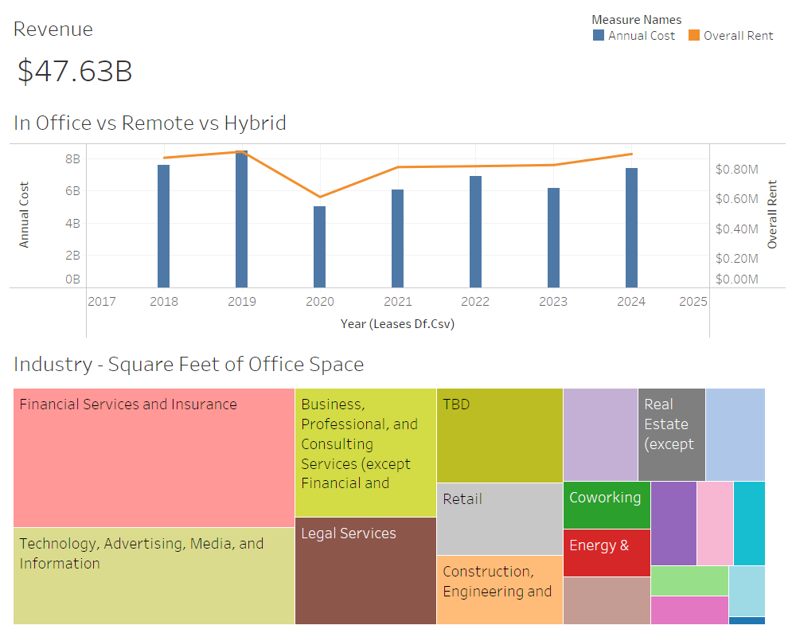

Slide 3
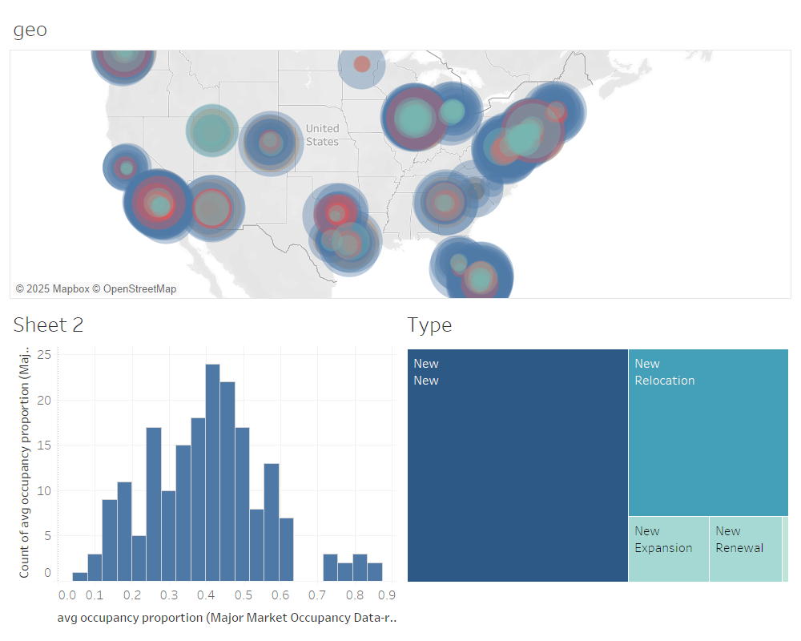

Slide 4
Where should companies move to? Places with growth of new offices with high profits

